Slide 1
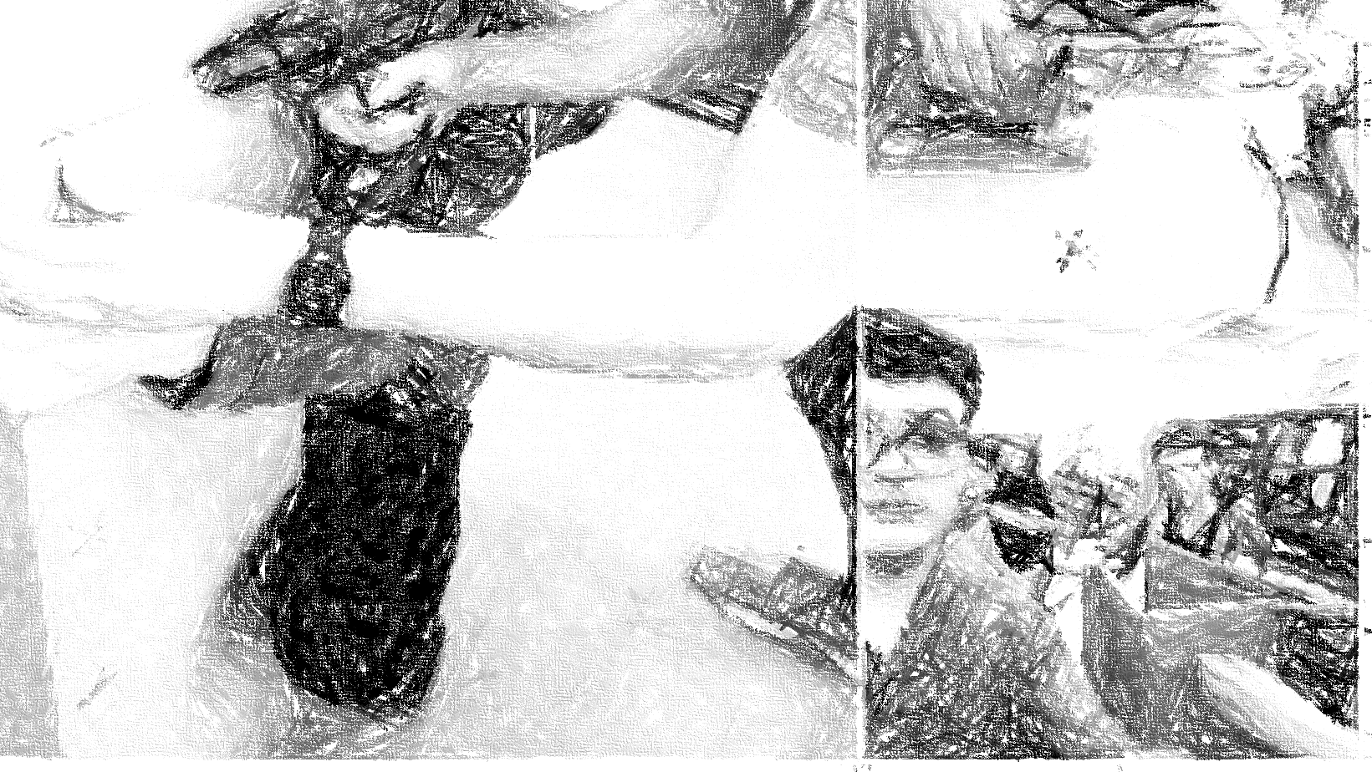
Smart Systems
Presentatie Poembak Delco

Slide 2
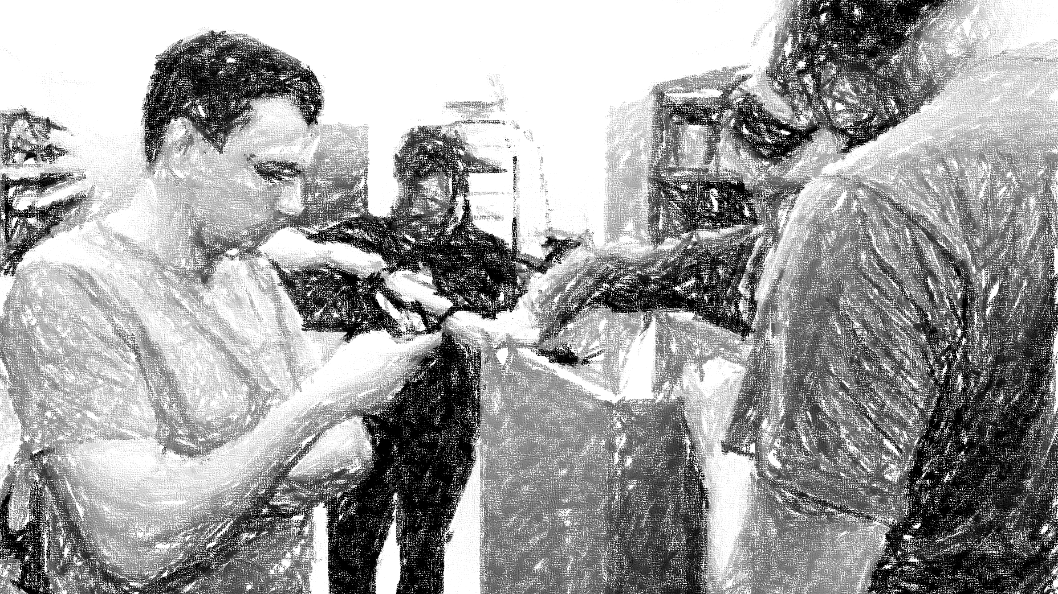
Meet the team
6 people, 1 robot

Slide 3
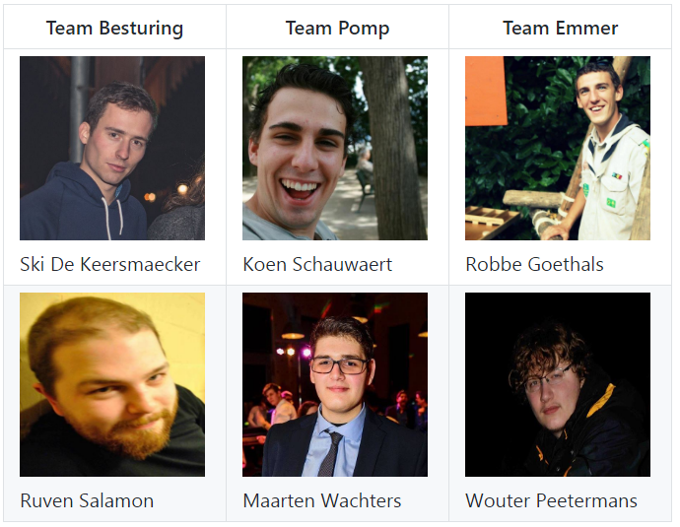

Slide 4
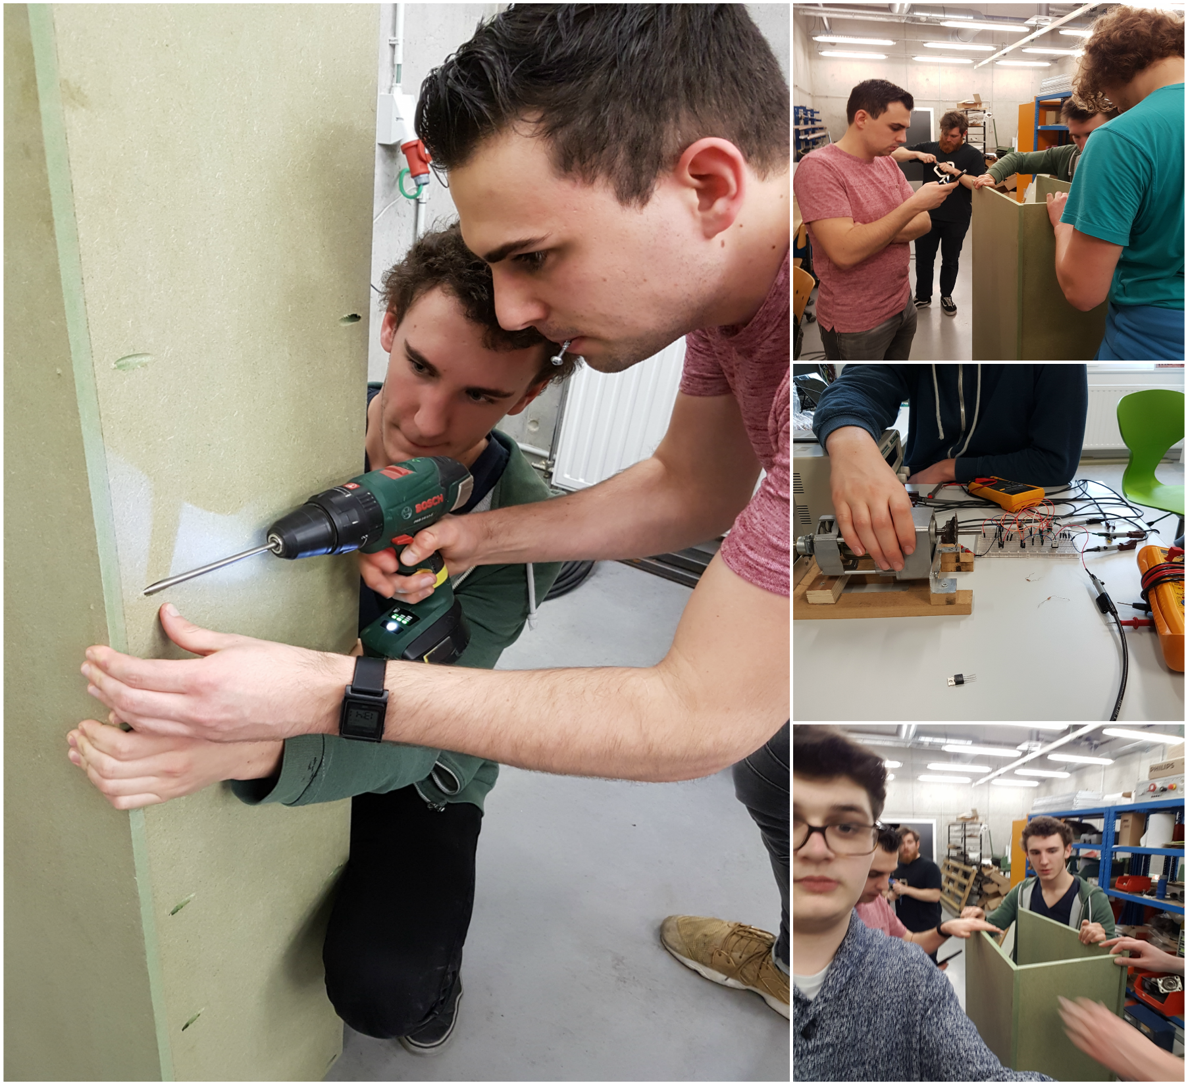

Slide 5


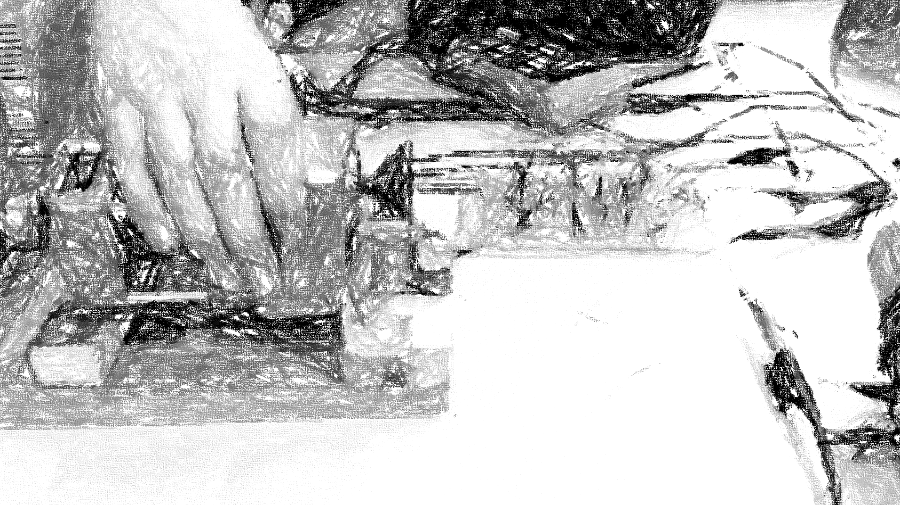



Progress

Slide 6
Checklist
Sponsoring CCM
Maken motorcontroller
Sturing motor
Sensoren inlezen
Doorsturen van data

Slide 7
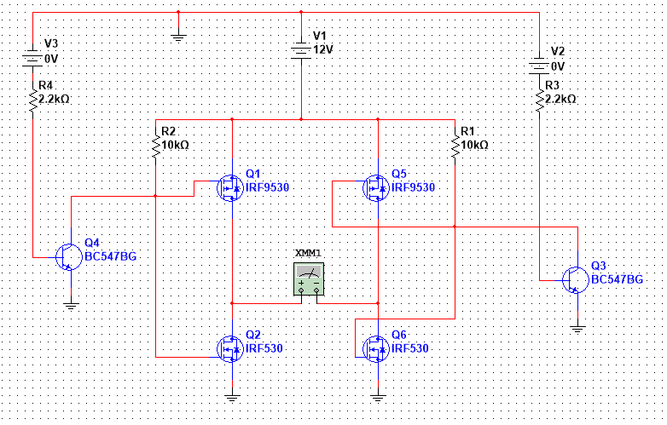
Schema motorcontroller

Slide 8
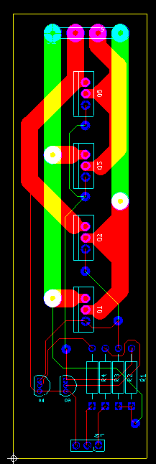
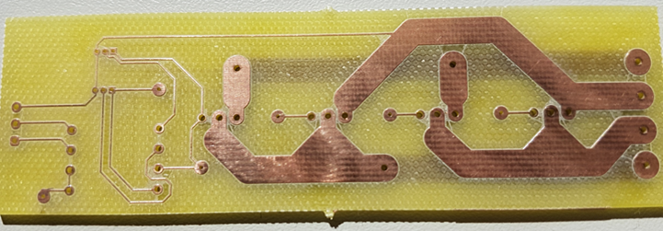
PCB motorcontroller

Slide 9
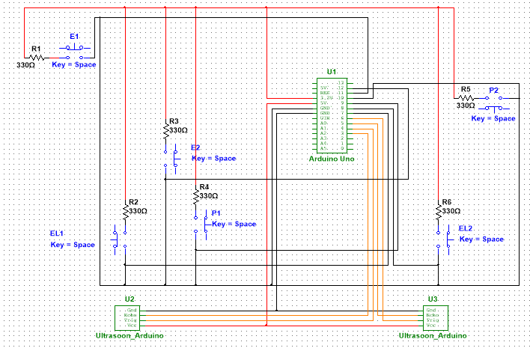
Schema circuit schakelaar

Slide 10
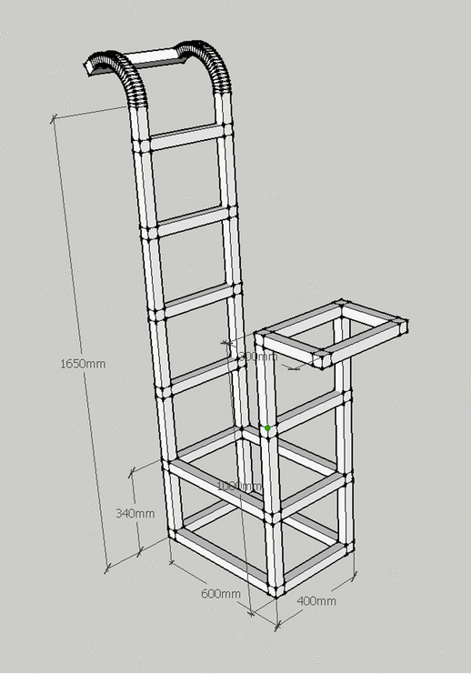
Frame

Slide 11
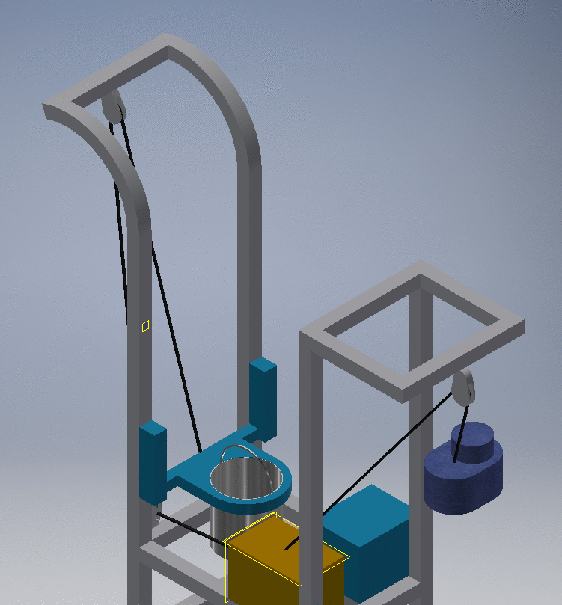
Beweging emmer

Slide 12
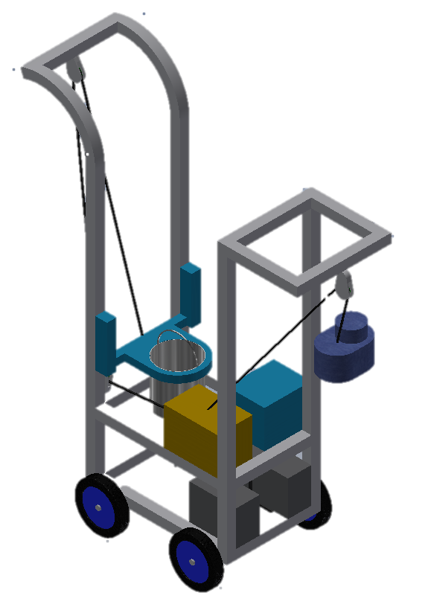
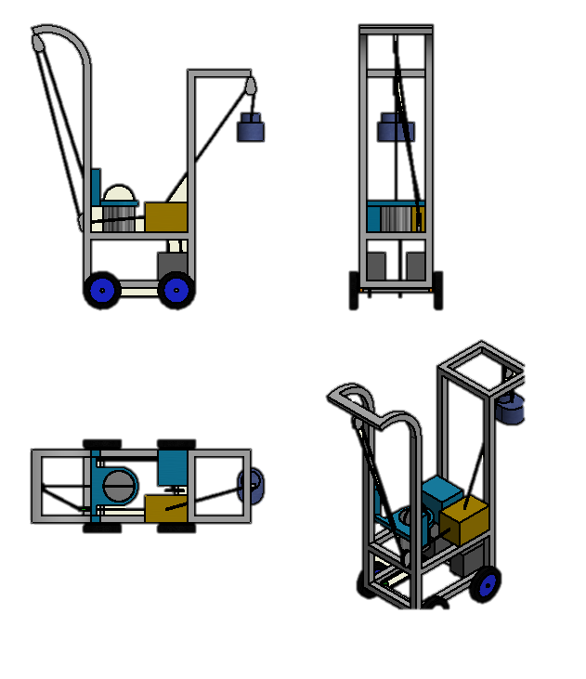
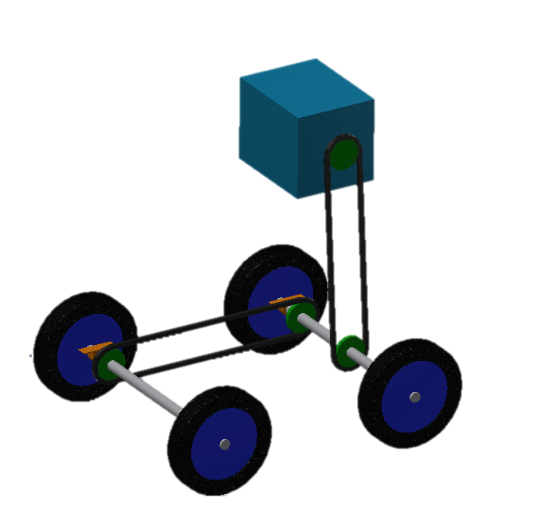

Slide 13
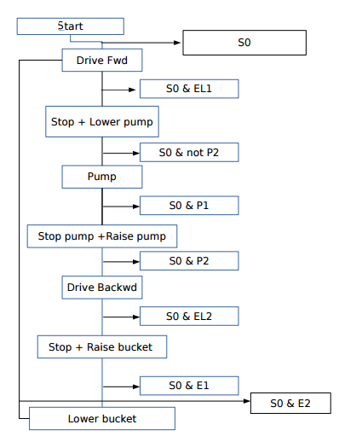
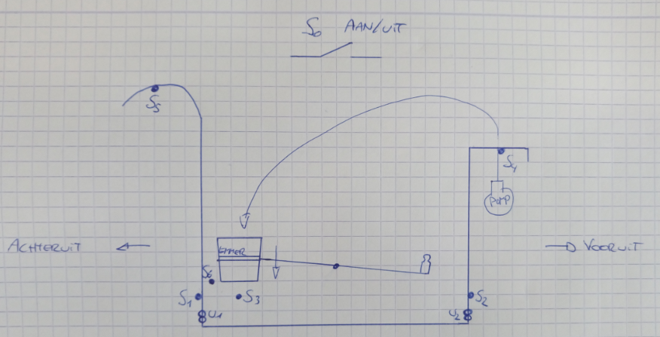
Graphset verloop

Slide 14
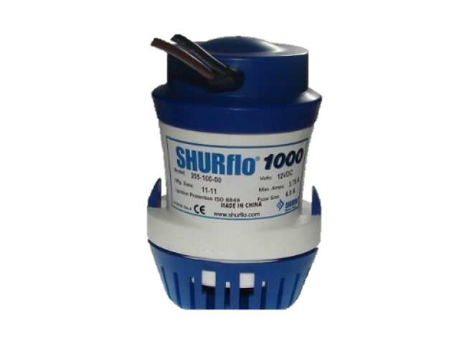

Slide 15
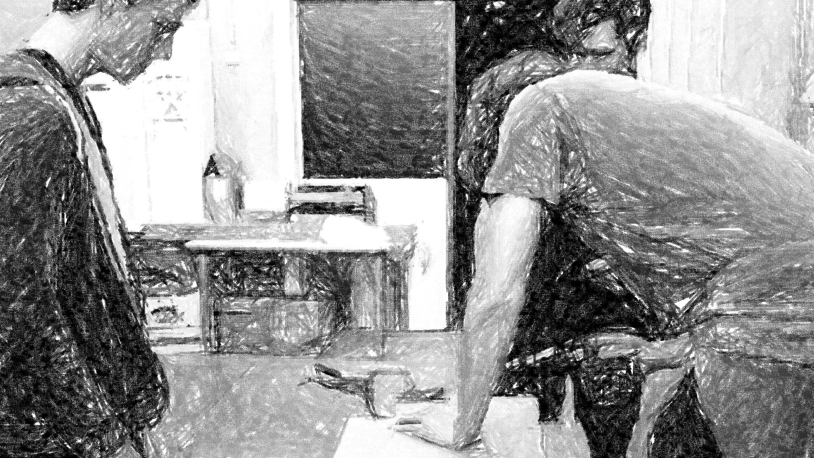
Documentatie

Slide 16
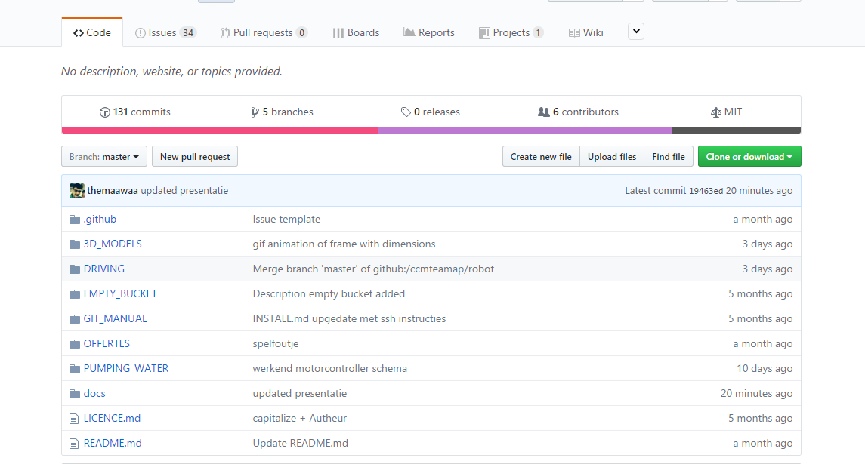

Slide 17
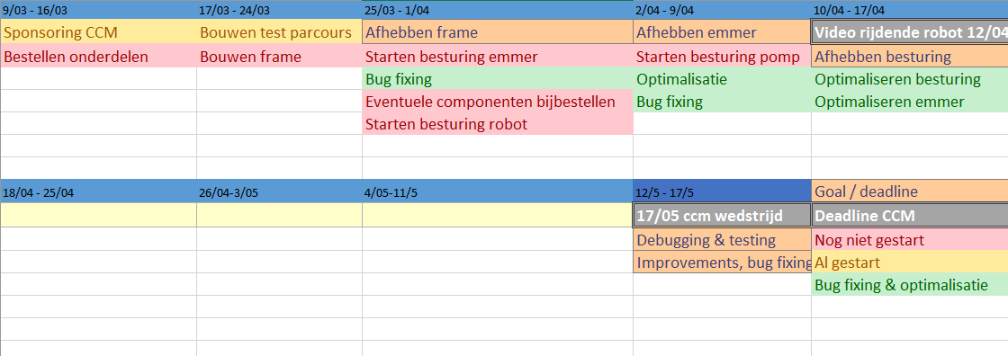
Planning

Slide 18
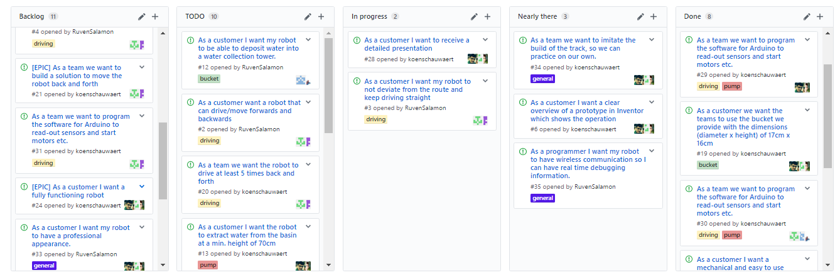
SCRUM

Slide 19
Links
Github: https://github.com/ccmteamap/robot
Wiki: https://github.com/ccmteamap/robot/wiki
Info CCM: http://www.ccm.nl/nl/trofee/
Issues & sprints: https://github.com/ccmteamap/robot/issues
Online scrum: https://github.com/ccmteamap/robot/projects/1

